Slide 1
Transabdominal Plane Block (UG-TAPB) in Bariatric Patients
Dr. Marco Cipolletta
Dirigente Medico
Presso AOU Federico II

Slide 2
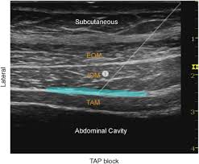
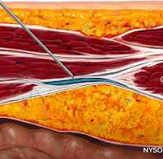
Objectives of the Presentation
Explore the efficacy of UG-TAPB
Discuss effects on pain, opioid use and PONV (postoperative nausea and vomiting)

Slide 3
What is UG-TAPB?
Definition
Regional anesthesiological technique: The TAP block (Transversus Abdominis Plane block) is a compartmental or neuro-fascial block technique that allows analgesia of the entire abdominal wall to be obtained through the injection of local anesthetic into the plane between the transversus abdominis muscle and the internal oblique muscle.
Indications
- Analgesia After Abdominal Aortic Surgery
-Biopsy and bone sampling
-Neurolysis with alcohol or phenol
-Treatment of pain flare-ups
-Analgesia for liver patients
-Bariatric patients

Slide 4
Advantages of TAP block
Recent international guidelines recommend performing ultrasound-guided TAP block as part of a multimodal analgesic regimen, since it can: Reduce opioids consumption Improve pain control and respiratory function Increase patient satisfaction Accelerate recovery of bowel function

Slide 5
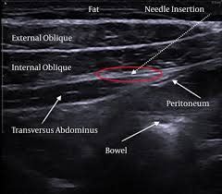
TAP block technique
Patient positioning
Identification of the anatomical plane
Injection of local anesthetic

Slide 6
Anatomy of the TAP block
It consists in its central part of the MR of the abdomen with its fascia and in the anterolateral part of three layers: OE, OI, TA with their respective fascia. The BP is innervated by the anterior branches of the spinal nerves from T7 to L1, the terminal branches of these somatic nerves run in the wall within a plane between OI AND TA
The anatomical plane of the TAP block It is located between the transversus abdominis muscle and the internal oblique muscle

Slide 7
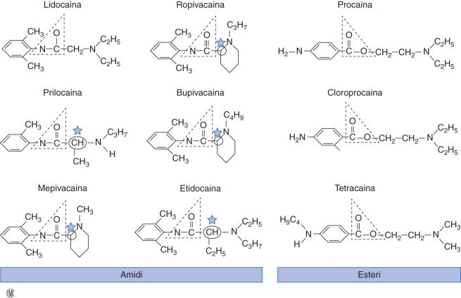
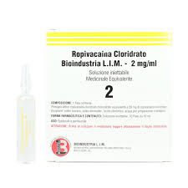
Pharmacology of the TAP block
Ropivacaine 0,2-0,5%
Bupivacaine 0,25-0,5%
Dexdor
Clonidine

Slide 8

Complications of TAP block
Vascular puncture Intraperitoneal injection Colon puncture Liver puncture Increased risk of Last (related to high volumes or failure to meet dosages) Infections N.B. If performed by experienced operators and with the aid of ultrasound guidance, it represents a relatively simple technique with an excellent safety profile for all approaches with a very low incidence of complications.

Slide 9
Contraindications
ABSOLUTE CONTRAINDICATIONS: Lack of consent to the procedure by the patient Presence in history of allergy to local anesthetics Infections in the abdomenal wall Localized anomalies at the site
RELATIVE CONTRAINDICATIONS Represented by surgery performed at the injection site and the presence of coagulopathy, although there is currently no scientific evidence.

Slide 10
Studies - PONV, PAIN AND OPIOID CONSUMPTION
Title | Design / Population | Main Results
Impact of Ultrasound-Guided TAP Block on Postoperative Pain and Early Outcome After Laparoscopic Bariatric Surgery | RCT, 92 patients with severe obesity (BMI ~49.5 kg/m²), laparoscopic bariatric surgery. TAP block under ultrasound guidance vs no block. | Significantly lower pain scores at 1 h and 6 h in the TAP group; reduced opioid use in the first 24 h; lower PONV; earlier mobilization; shorter time to first flatus. No difference in hospital length of stay.
Systematic Review and Meta-Analysis: TAP in Laparoscopic Bariatric Surgery | Meta-analysis of 7 RCTs (~617 patients). TAP block vs no block in laparoscopic bariatric patients. | No significant difference in 24 h opioid consumption or resting pain scores at 24 h; significant reduction in PONV and shorter time to ambulation with TAP block.
The Analgesic Efficacy of TAP Block After Bariatric Surgery: Systematic Review and Meta-Analysis with Trial Sequential Analysis | 13 trials (~1025 patients). TAP block vs control (no block/placebo) in bariatric surgery. | At 2 h post-op: significantly lower resting pain (MD ≈ −1.8 on 0–10 scale); also lower pain at 12 and 24 h. Opioid consumption was lower at multiple time points in TAP groups. No significant differences in major complications.
Laparoscopic-Assisted TAP Block vs Port-Site Infiltration | RCT, 113 bariatric surgery patients. TAP block vs local infiltration at trocar sites. | At 24 h, VAS scores were similar between groups; no differences in opioid use, PONV, hospital stay, or patient satisfaction. Conclusion: port-site infiltration is a valid and technically simpler alternative.
Efficacy of Laparoscopic-Guided TAP Block in Postoperative Pain Management of Laparoscopic Bariatric Patients | RCT, 46 bariatric patients. Laparoscopic TAP block vs control. | Significantly fewer patients required rescue analgesia (30.4% vs 65.2%); better pain scores during movement/ambulation in the TAP group. Resting VAS and PONV were not statistically different.

Slide 11
Technical difficulties in performing TAP block for bariatric surgery
Increased thickness of the adipose panniculus:
Greater distance between skin and muscle layers → more challenging ultrasound visualization.
Reduced ultrasound resolution:
Beam attenuation through adipose tissue → less defined images, often requiring low-frequency probes.
More complex anatomical identification:
Possible alteration of muscle planes in obesity → increased risk of incorrect needle placement.
Difficulty maintaining optimal transducer and needle positioning, especially in patients with very high BMI.

Slide 12
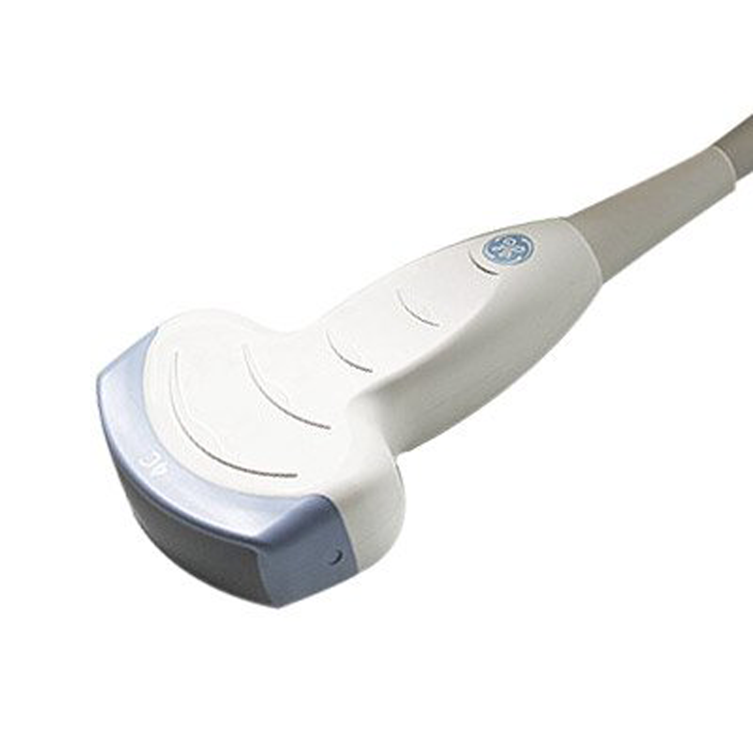
Strategies to improve TAP block success in obese patients
Select an appropriate ultrasound probe (low-frequency, convex) to achieve better tissue penetration.
Use a more acute needle angle and longer needles (≥100 mm) to reach the correct plane.
Apply moderate probe compression to reduce the skin–muscle distance and enhance image quality.
Perform bilateral blocks systematically, often necessary to adequately cover multiple surgical sites (e.g., multiport bariatric laparoscopy).
Operator experience matters: longer learning curve → TAP block should ideally be performed by anesthesiologists experienced in ultrasound-guided regional anesthesia.

Slide 13

Thank you

